Slide 1
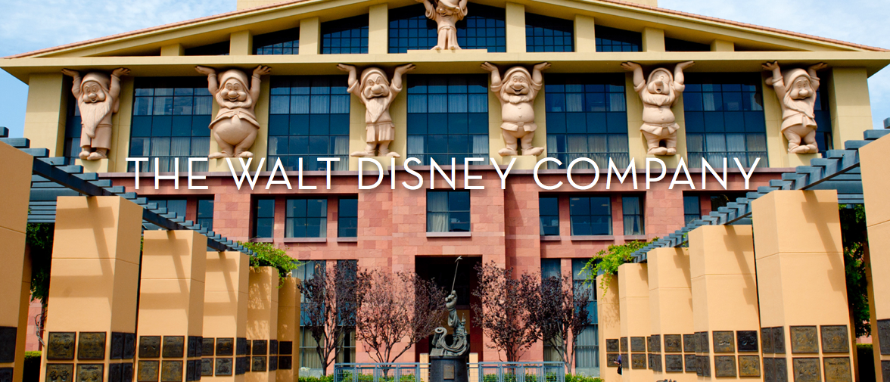

Presentation on
Industry/Company Viewpoints and Opportunity for Capgemini
Prepared by AH

Slide 2
TABLE OF CONTENTS
1
INDUSTRY SPECIFIC INSIGHTS
3
1.1
MARKET OVERVIEW
4
1.2
KEY INDUSTRY TRENDS
7
2
COMPANY SPECIFIC INSIGHTS
8
2.1
BUSINESS MODEL
9
2.2
VALUE CHAIN
10
2.3
STRATEGIC PRIORITIES
11
2.4
GROWTH CHALLENGES
12
2.5
RESPONSE TO GROWTH CHALLENGES
13
3
OPPORTUNITIES FOR CAPGEMINI
14

Slide 3

INDUSTRY SPECIFIC INSIGHTS
IT Technology and Engineering Services in Media & Entertainment

Slide 4
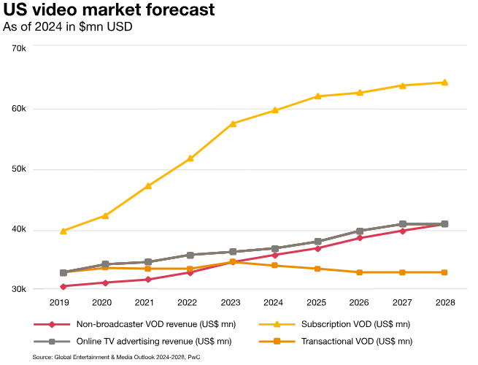
MARKET OVERVIEW (1/3)
U.S. M&E Overall Size, Structure, and Growth:
In 2023, The U.S. Media and Entertainment (M&E) industry, the largest globally at $654.6 billion (part of the $2.8 trillion global market), is expected to grow to $808.0 billion by 2028 at an annual rate of 4.3%.
The M&E industry includes businesses involved in producing, distributing, and offering ancillary digital services and products for motion pictures, TV programs, commercials, streaming content, music, video and audio recordings, broadcast, radio, text and book publishing, eSports, and video games.
The US M&E industry is poised for continued growth, driven by factors such as increasing digital consumptions, technological advancements, and global expansion.
4.3% CAGR
Video
The U.S., as the largest market and the epicenter of the global streaming revolution, is projected to see its total OTT video revenue grow at a strong 7.7% CAGR, rising from US$69.3 billion in 2023 to US$100.5 billion by 2028.
This growth will outpace the global average, which is forecasted at a 7.4% CAGR. By 2028, the U.S. is expected to account for nearly half of global OTT revenue.
However, reaching this milestone will require U.S. operators to redefine their business models, addressing excessive spending driven by overly ambitious growth and profit expectations.
Source: PwC Global Entertainment & Media Outlook 2024-28, 2022 KPMG U.S. Technology Survey Report, International Trade Administration (ITA), Omdia, etc.

Slide 5
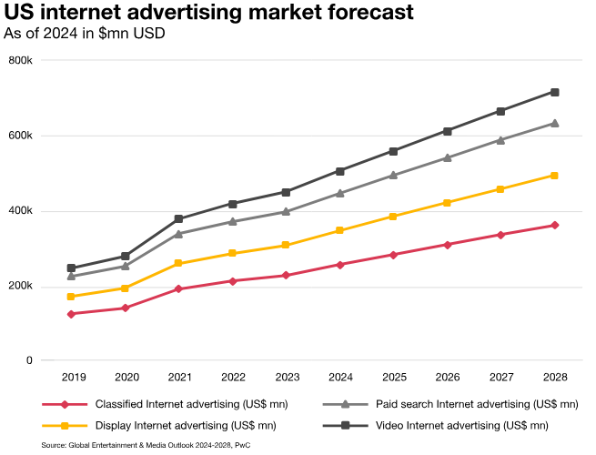
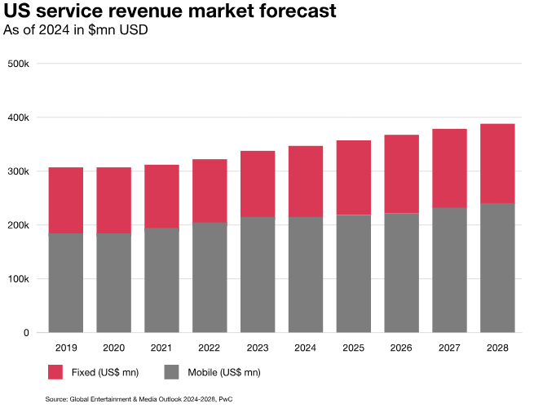
MARKET OVERVIEW (2/3)
Advertising
U.S. internet advertising growth is increasingly driven by the demand to reach consumers across multiple platforms, including phones, gaming, e-commerce sites, and on the go.
In 2023, the market expanded by 7.3% year-on-year, reaching US$225.0 billion, with expectations of continued growth at a 9.7% CAGR, reaching US$357.5 billion by 2028.
The connected TV video advertising segment has been the fastest-growing part of the market, gradually shifting spend away from more traditional formats such as linear TV
Internet Access
The U.S. stands at the forefront of the tech and telecom industries, particularly in the streaming revolution, and is by far the largest market for Internet access globally.
With its substantial market size and high average revenue per user (ARPU), the U.S. is projected to generate about US$52.7 billion more annually by the end of the forecast period than the combined totals of China, Japan, and India—the second, third, and fourth largest markets.
This growth in Internet access revenue is driven by consumer demand for more advanced and powerful services, with AI emerging as the leading technology in demand.
Gen AI
The U.S. artificial intelligence (AI) market is a global hub for innovation and investment, cementing the country's leadership in AI development worldwide, with nearly half of CEOs expecting GenAI to boost profits this year and 61% seeing improvements in product quality.
While AI in E&M has mainly focused on cost control, the real challenge is how GenAI will generate new revenue streams and accelerate access to emerging opportunities
Source: PwC Global Entertainment & Media Outlook 2024-28, 2022 KPMG U.S. Technology Survey Report, International Trade Administration (ITA), Omdia, etc.

Slide 6
MARKET OVERVIEW (3/3)
Key Sub-Segments:
IT Technology and Engineering Services in Media & Entertainment (Potential Market):
The U.S. IT services market for the E&M sector is estimated to reach $30 billion in 2023, growing at a CAGR of 6-8%. This growth is driven by the increasing digitization of operations, expansion into streaming, the rising demand for digital transformation, innovations in content creation and distribution, and advancements in AI, cloud computing, and cybersecurity.
The IT and engineering services market for the E&M sector includes key sub-segments such as Digital Media & OTT, Gaming & Interactive Media, Advertising Technology, Cybersecurity, and Content Creation & Production.
The OTT video market is expected to reach $100 billion by 2028, creating growth opportunities for IT services in content management, delivery, and data analytics. The gaming industry, projected to hit $250 billion by 2028, will drive demand for IT infrastructure and game development services, particularly in cloud gaming and esports.
As U.S. digital ad spending grows towards $357 billion by 2028, the need for advanced ad tech solutions, AI-driven audience targeting, and data analytics will rise, benefiting IT service providers. Additionally, the cybersecurity market within E&M is set to expand as media companies increase investments to safeguard content, data, and intellectual property. The Content Creation & Production segment will continue to rely on IT solutions such as cloud-based management, digital media services, and automation tools to streamline production workflows
Source: PwC Global Entertainment & Media Outlook 2024-28, 2022 KPMG U.S. Technology Survey Report, International Trade Administration (ITA), Omdia, etc.

Slide 7
KEY INDUSTRY TRENDS
Current Trends
Future Trends
Streaming has become the dominant form of media consumption, surpassing traditional TV
Consumers expect on-demand access across devices, with SVOD & AVOD platforms offering tiered content services
Companies, such as Disney+ and Netflix are expanding globally to grow their audience
Integration of AI & ML in Content Creation
AI is transforming content creation by automating tasks like scriptwriting, video editing, and CGI production, making content creation faster and more cost-effective
Generative AI models like GPT-3 generate scripts and synthetic actors, while AI is expected to play a larger role in production process, reducing costs and reliance on human labor
Rise of Streaming And OTT Services
AI-driven recommendations and data analytics are transforming content delivery by personalizing experiences for users. This increases engagement, satisfaction, and retention
Streaming platforms track user behavior to offer tailored content, while media companies use analytics and machine learning to predict what will resonate with audiences
Blockchain is transforming the media sector by enhancing digital rights management, secure content distribution, and reducing piracy. It ensures fair compensation through real-time royalty tracking, smart contracts, and tokenization of media assets, creating new revenue streams for creators.
As decentralized models grow, blockchain will play a key role in content creation and distribution.
Leveraging AI & Analytics to Drive Data & Content Personalization
Wider Adoption of Blockchain for Content Distribution
Cloud technology is transforming the Media and Entertainment sector by offering scalable solutions to meet growing content demands without heavy hardware investments
Major cloud providers like AWS, Azure, and Google Cloud offer specialized media services, while media companies adopt cloud-native apps for greater agility and faster content distribution
The entertainment industry is adopting AR and VR to create immersive experiences, with VR offering full immersion and AR blending digital elements with the real world.
Companies like Disney and Universal are exploring these technologies for theme parks and live events.
VR gaming is growing rapidly, and AR/VR is expected to become mainstream, transforming entertainment, education, and gaming experiences.
Rising Cloud Adoption
Adoption of AR/VR to Enhance Consumer Experiences
Digital transformation is driving change in Media and Entertainment, with companies adopting automation and AI tools to streamline content creation, editing, distribution and marketing
Automation and AI streamline production, editing, and delivery, ensuring real-time content and accurate distribution across channels
The rollout of 5G will transform media and entertainment by enabling faster streaming, ultra-low latency, and new gaming, AR/VR, and live event experiences
5G will allow seamless 4K/8K streaming, enhance real-time interactions, and power cloud gaming without high-end hardware, offering content creators new opportunities to innovate and engage audiences
Digital Media Transformation and Automation
5G Network Expansion to Boost Streaming & Immersive Media
Source: EY (2024 Media and Entertainment Trends), Deloitte (2024 Media and Entertainment Outlook), Forbes, PwC Global Entertainment & Media Outlook 2024-28, 2022 KPMG U.S. Technology Survey Report, etc.

Slide 8

COMPANY SPECIFIC INSIGHTS

Slide 9




BUSINESS MODEL
The Walt Disney Company, along with its subsidiaries, is a globally diversified entertainment conglomerate, operating in three key business segments: Sports, Entertainment, and Experiences.
The Entertainment segment covers the Company’s global activities in film, television, and direct-to-consumer (DTC) video streaming, excluding sports content. Key business areas within Entertainment include linear networks, DTC services, content sales and licensing, and other related activities.
The Sports segment focuses on global sports content production and distribution, both through television and DTC platforms. Major business lines include ESPN (domestic and international) and Star (India). The primary revenue sources for this segment are affiliate fees, advertising, subscription fees, and other earnings.
The Experiences segment includes Parks and Experiences, as well as Consumer Products. Revenue in this segment comes from theme park admissions, resort vacations, food and beverage sales, merchandise, retail, and licensing.
Entertainment
Linear Networks
Affiliate Fees
Advertising
Other
Direct-to-Consumer
Subscription Fees
Advertising
Other
Content Sales/ Licensing and Other
Merchandise Distribution Licensing
TV/VOD Distribution Licensing
Theatrical Distribution Licensing
Home Entertainment Distribution
Experiences
Theme Park Admissions
Resort and Vacations
Retail and Wholesale Sales of Merchandise, Food and Beverage
Merchandise Licensing And Retail
Parks Licensing and Other
Sports
Affiliate Fees
Subscription Fees
Advertising
TV/VOD Distribution Licensing
Source: Annual Report (Annual Financial Report-Fiscal Year 2023), Company Website, etc.

Slide 10
VALUE CHAIN
FIRM INFRASTRUCTURE
(Ex: Financing, Planning, Investor Relations)
HUMAN RESOURCE MANAGEMENT
(Ex: Recruiting, Training, Compensation System)
Support Activities
Margin
TECHNOLOGY DEVELOPMENT
(Ex: Product Design, Process Design, Market Research)
PROCUREMENT
(Ex: Services, Machines, Advertising, Data)
Value
What Buyers
Are willing
To pay
INBOUND
LOGISTICS
OPERATIONS
OUTBOUND LOGISTICS
MARKETING & SALES
AFTER-SALES SERVICE
Customer Access, Data Collection, Incoming Material Storage, Receiving, Disseminating, Service
Branch Operation, Maintenance, Assembly Component Fabrication, Inventory, Quality Management
Order Processing, Warehousing, Report Preparation, Material Handling, Scheduling, Distribution, Processing
Sales Force, Promotion, Advertising, Proposal Writing, Website, Pricing, Building Relations, Quoting
Installation, Customer Support, Complaint Resolution, Repair
Diverse and Large Suppliers Network
Supply-Chain Investment Program
Standard and Regulations for Suppliers
Software Developer
Design New Product
Post Editing
Games Developing
Manage Administration
Deliver Quality
Web Page Creating
Disney Media Distribution
Broadcasting
New Events
Games
Web Pages
Cross Channels
Brand Ambassadors
Advertising
Promotion Event/Ad
Buzz Spreading
Sales Event
Horizontal Alliances
Maintaining Web Pages
Quality Guarantee
Real-Time Communication
Content Updating
Interaction with Viewers
Margin
Primary Activities
Source: EMBA Pro, Investor Presentations, Company Website, Case Studies, Blogs, Whitepapers, etc.

Slide 11
STRATEGIC PRIORITIES
Invest Strategically
in Experiences
Disney is making strategic investments in its most profitable segment, Experiences
Strong return on invested capital (ROIC) and innovation are driving Disney’s investment strategies
The company announced a ~$60 billion investment plan over next 10 years, which includes funding for the expansion of parks & cruise line capacity
Building on a proven track record of delivering exceptional returns, Disney's FY23 ROIC was nearly 2.5 times the cost of capital
Rationalize Cost
Disney is optimizing costs and driving operational efficiency
The company has consistently adhered to a disciplined and balanced approach to capital allocation
While focusing on additional cost efficiencies, Disney remains committed to maintaining quality, growth, and value creation
By the end of FY24, Disney expects to achieve at least $7.5 billion in annual cost savings, surpassing the $5.5 billion target set in February 2023
Continue Building ESPN into the Preeminent Digital Sports Platform
Disney+ and ESPN+ are key pillars of Disney's strategy. The company is focused on strengthening ESPN as the leading digital sports platform
Disney has announced a sports streaming service in partnership with Fox and Warner Bros. Discovery, with a target launch in Fall 2024, and plans to debut the ESPN flagship service in Fall 2025.
Additionally, Disney has entered into an agreement with PENN Entertainment, which launched ESPN BET in November 2023
Content Innovation and Diversification
Central to Disney's diversification strategy is its strong focus on producing engaging content across its platforms
By capitalizing on its iconic franchises and investing in original programming, Disney seeks to captivate global audiences and boost engagement on its streaming services
Reinvigorate Creativity,
Driving Unmatched IP Engine
For over 100 years, Disney’s unmatched intellectual property (IP) and storytelling have been key strategic advantages
The company has restructured to empower creative teams with greater decision-making authority throughout the content lifecycle
Disney is placing a strong emphasis on enhancing the creative output of its film studio, reducing the volume of projects, and improving return on investment. Additionally, the focus is on leveraging core brands and franchises to drive higher returns
Technological Advancements and Investments
Disney is making significant investments in cloud services, AI, and digital tools to enhance content creation, consumer engagement, and strengthen its presence across multiple content platforms
Approximately 30% of the company’s investment plans for the next 10 years are allocated to technology and maintenance integration
Disney's strategy invests in advanced technology to enhance content delivery, personalization, and user interfaces for tech-savvy consumers
Source: Disney’s Plan For Shareholder Value Creation (March 2024), Proxy Statement of The Walt Disney Company(02/01/24), Kagan, Wall Street Research, Insider Intelligence (eMarketer), Investor Presentations, etc.

Slide 12










GROWTH CHALLENGES
Declining Traditional Media Revenues
Disney's revenues from traditional TV and cable have declined as on-demand streaming, especially among younger audiences, becomes more popular
Cost Management and Profitability
Disney faces profitability challenges from high content production costs, streaming investments, and rising park expenses due to economic factors and inflation
Changing Consumer Behaviour
Rise of streaming platforms has reduced traditional TV viewership and ad revenue, pushing Disney to offer more diverse and inclusive content to attract younger audiences
Sustainability and Environmental Responsibility
Disney faces pressure to improve sustainability across its operations, focusing on energy use, waste management, and sourcing sustainable materials
Intensifying Competition
Surge of streaming platforms has increased competition for viewers and content, putting pressure on Disney to continually innovate and expand its streaming services
Economic Uncertainty
Disney's theme parks depend on consumer spending, and factors such as inflation, rising costs, and economic downturns can impact attendance and merchandise sales
Technology Overhaul
Disney's outdated legacy systems require modernization to stay competitive, improve efficiency, and adopt agile technologies for growth
Talent Acquisition and Retention
Disney faces fierce competition for top talent in content creation, technology, and digital marketing as it expands its digital and streaming services
Source: Disney's Q1 2024 Report, Forbes, Investor Presentations, Company Website, Case Studies, Blogs, Whitepapers, etc.

Slide 13








RESPONSE TO GROWTH CHALLENGES
Intensifying Competition
Disney uses its iconic content library to differentiate Disney+ and expand globally, with plans to merge ESPN+ and Hulu into Disney+ for a more unified streaming offering
Declining Traditional Media Revenues
Disney is expanding its streaming services, focusing on original content and iconic franchises, while adopting a direct-to-consumer model to stay relevant in the evolving media landscape
Changing Consumer Behaviour
Disney is meeting new demands by introducing interactive content, live events, and using AI to personalize Disney+ offerings, attracting younger, tech-savvy audiences
Cost Management and Profitability
Disney aims to save $7.5 billion annually by FY24, streamline operations, and focus on high-quality, cost-effective content by restructuring its content creation and distribution processes
Technology Overhaul
Disney is modernizing its legacy systems through investments in cloud, AI, and data analytics to improve efficiency, enhance user experience, and drive innovation
Sustainability and Environmental Responsibility
Disney aims for net-zero carbon emissions by 2050, implementing sustainability initiatives such as energy efficiency, renewable energy, and water conservation across its operations
Economic Uncertainty
Disney is investing $60 billion over the next decade to expand parks and resorts, while using advanced technologies to enhance operations and guest spending
Talent Acquisition and Retention
Disney drives innovation by empowering creative teams, investing in training, and offering competitive compensation to attract top talent, while focusing on tech-driven content to appeal to young professionals

Slide 14

OPPORTUNITIES FOR CAPGEMINI

Slide 15






OPPORTUNITIES FOR CAPGEMINI (1/2)
04
06
02
03
05
01
Integrating AI and Data Analytics
Focusing on Digital Transformation
Implementing Blockchain Technology
Capgemini can help Disney leverage AI-powered data analytics to deliver personalized content recommendations, optimize audience targeting, and improve content strategies across platforms, enhancing customer engagement and satisfaction
Capgemini can enhance Disney's efficiency and agility by automating processes and modernizing workflows in areas like supply chain, content distribution, theme park operations, and customer support
Capgemini can help Disney strengthen its digital rights management and secure content distribution by implementing blockchain technology, protecting intellectual property, reducing piracy risks, and enabling new monetization opportunities for digital content
Provide Immersive Experiences
Leveraging Cloud Solutions and IT Modernization
Implementing Cybersecurity Solutions
Capgemini can help Disney enhance theme park operations and guest experiences by integrating AI, IoT, and cloud services, optimizing guest flow, personalizing experiences, and using predictive analytics for crowd management and tailored recommendations
Capgemini’s cloud expertise can help Disney modernize its IT systems, enhance Disney+ and content delivery, and optimize infrastructure, enabling the integration of AI, machine learning, and blockchain to drive efficiency, security, and innovation
Capgemini’s cybersecurity expertise can help Disney strengthen its digital security, protect customer data, and ensure compliance with privacy regulations by implementing advanced security protocols, real-time threat detection, and secure payment systems to combat evolving cyber threats

Slide 16






OPPORTUNITIES FOR CAPGEMINI (2/2)
Strategic Alignments
Customer-Centric Innovation
Capgemini can collaborate with Disney to innovate customer-facing products and services by enhancing engagement and interactivity across platforms, such as personalized streaming, advanced theme park apps, and AI-driven chatbots
This partnership will ensure Disney delivers a seamless, personalized, and innovative experience to its diverse customer segments
Operational Efficiency
Capgemini’s cutting-edge IT solutions assist Disney in optimizing operations, boosting efficiency, and lowering costs
By streamlining global business processes, Capgemini helps Disney reduce redundancies, enhance decision-making through intelligent automation and data insights, and scale operations while maintaining high service quality and customer satisfaction
Technology Enablement
Capgemini’s technical expertise can guide and support Disney's IT modernization by upgrading legacy systems, integrating cloud platforms and AI, and ensuring scalable, secure infrastructure
This technology enablement will help Disney optimize resources, innovate faster, and deliver superior user experiences
Partnership Proposal
Joint Development of Digital Solutions
Capgemini and Disney can work together to develop innovative digital solutions for enhancing content management, distribution, and personalized viewing experiences
By leveraging Capgemini's digital expertise, Disney can develop AI-driven content recommendations, optimize distribution networks, and deliver a more tailored, immersive experience for Disney+ subscribers, positioning both companies to stay at the forefront of evolving content consumption trends
End-to-End IT Modernization
Capgemini can support Disney in modernizing its legacy IT systems, helping the company adopt flexible, secure, and scalable solutions for both current and future needs
By re-engineering business processes and integrating advanced technologies like cloud services, AI, and blockchain, Capgemini enables Disney to transition to a more agile infrastructure
This modernization will enhance Disney’s operational efficiency, reduce costs, and improve its ability to respond to market demands
Consulting for Global Expansion
Capgemini will guide Disney through technology integration, regulatory challenges, and market entry as it expands into new global markets
Leveraging its global business operations expertise, Capgemini will offer strategic guidance and IT support to optimize Disney’s digital infrastructure for these regions
Capgemini will tailor Disney's offerings to local markets and ensure compliance, enabling smoother expansions and accelerated global growth

Slide 17
THANK YOU

